Slide 1
Network Insecurity
CSE 545 – Software Security
Spring 2017
Adam Doupé
Arizona State University
http://adamdoupe.com
Content of some slides provided by Giovanni Vigna of UCSB, with approval

Slide 2
The Internet Protocol Suite
Set of protocols used to transport data between nodes of a network
Also known as the TCP/IP Protocol Suite
Based on abstraction and encapsulation
Link protocols
Internet protocols
Transport protocols
Application protocols

Slide 3
TCP/IP Layering
HTTP
SMTP
DNS
NFS
Application
TCP
UDP
Transport
IGMP
IP
ICMP
Internet
ARP
Hardware Interface
RARP
Link
Physical Layer

Slide 4
IP Addresses
Each host has one or more IP addresses for each network interface
IPv4 addresses are composed of 32 bits (class+netid+hostid)
Represented in dotted-decimal notation: 149.169.175.207
Classes
Class A (0): netid=7 bit (128 networks, actually 1-126), hostid=24 bit (16777216 hosts)
Class B (10): netid=14 bit (16384 networks), hostid=16 bit (65536 hosts)
Class C (110): netid=21 bit (2097152 networks), hostid=8 bit (256 hosts)
Class D - Multicast (1110): multicast addresses
Class E (1111): reserved or future use

Slide 5
Classless Inter-Domain Routing (CIDR)
Allocation of large chunks of IP addresses wasted an enormous number of IP addresses
Number of hosts is increasing
IPv6 provides a larger address space but adoption is slow
CIDR is an addressing scheme from 1993 for the Internet which allows for more efficient allocation of IP addresses than the old “Class A, B, and C” address scheme
The netid/hostid boundary can be placed on any bit between 13 and 27
32 hosts minimum
524,288 hosts maximum

Slide 6
Internet Protocol (IP)
The IP protocol represents the “glue” of the Internet
The IP protocol provides a connectionless, unreliable, best-effort datagram delivery service (delivery, integrity, ordering, non-duplication, and bandwidth is not guaranteed)
IP datagrams can be exchanged between any two nodes (provided they both have an IP address)
For direct communication IP relies on a number of different lower-level protocols, e.g., Ethernet, Token Ring, FDDI, RS-232, 802.11

Slide 7
IP Datagram – RFC 791
0
4
8
12
16
20
24
28
31
Version
HL
Service type (TOS)
Total length
Identifier
Flags
Fragment offset
Time To Live
Protocol
Header checksum
Source IP address
Destination IP address
Options
Padding
Data

Slide 8
IP Header
Normal size: 20 bytes
Version (4 bits): current value=4 (IPv4)
Header length (4 bits): number of 32-bit words in the header, including options (max header size is 60 bytes)
Type of service (8 bits): priority (3 bits), quality of service (4 bits), and an unused bit
Total length (16 bits): datagram length in bytes (max size is 65535 bytes)
Id (16 bits): unique identifier for the datagram (usually incremented by one)

Slide 9
IP Header
Flags (3 bits) and offset (13 bits): used for fragmentation
Time To Live (8 bits): specifies the max number of hops in the delivery process
Protocol (8 bits): specifies the protocol encapsulated in the datagram data (e.g., TCP or UDP)
Header checksum (16 bits): checksum calculated over the IP header
Addresses (32+32 bits): IP addresses of the source and destination of the datagram

Slide 10
IP Options
Variable length
Identified by first byte
Security and handling restrictions: used in military applications
Record route: each router records its IP address
Time stamp: each router records its IP address and time
Source route: specifies a list of IP addresses that must be traversed by the datagram
Many others…

Slide 11
IP Encapsulation
IP header
IP data
Frame header
Frame data

Slide 12
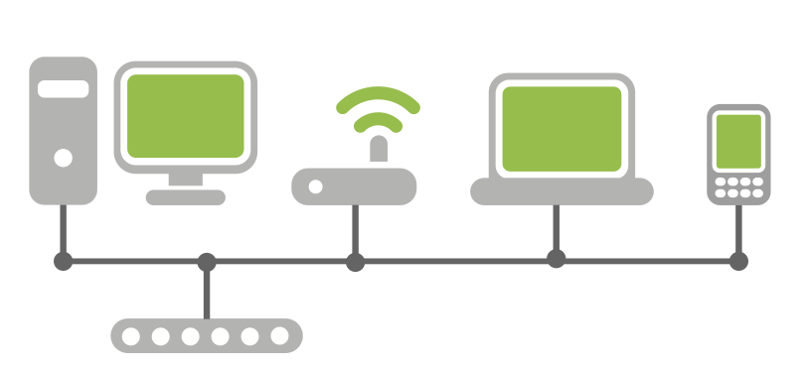
IP: Direct Delivery
If two hosts are in the same physical network the IP datagram is encapsulated in a lower level protocol and delivered directly
Subnetwork 111.10.20
111.10.20.121
111.10.20.14
From 111.10.20.121
To 111.10.20.14
09:45:FA:07:22:23
0A:12:33:B2:C4:11
From 09:45:FA:07:22:23
To 0A:12:33:B2:C4:11

Slide 13
Ethernet Frame
dest (6)
src (6)
type (2)
data (46-1500)
CRC (4)
0x0800
IP datagram
0x0806
ARP (28)
PAD (18)
0x0808
RARP (28)
PAD (18)

Slide 14
Ethernet
Widely-used link-layer protocol
Uses CSMA/CD (Carrier Sense, Multiple Access with Collision Detection)
Destination address: 48 bits (e.g., 09:45:FA:07:22:23)
Source address: 48 bits
Type: 2 bytes (IP, ARP, RARP)
Data:
Min 46 bytes (padding may be needed)
Max 1500 bytes
CRC: Cyclic Redundancy Check, 4 bytes

Slide 15
Address Resolution Protocol
The address resolution protocol (ARP) allows a host to map IP addresses to the link-level addresses associated with the peer’s hardware interface (e.g., Ethernet) to be used in direct delivery
ARP messages are encapsulated in the underlying link level protocol

Slide 16
Address Resolution Protocol
Host A wants to know the hardware address associated with the IP address of host B
Host A broadcasts a special message to all the hosts on the same physical link
Host B answers with a message containing its own link-level address
Host A keeps the answer in its cache
To optimize traffic exchange, when host A sends its request it also includes its own IP address
The receiver of the ARP request will cache the requester mapping

Slide 17
ARP Messages
Hw type
Prot type
Hw size
Prot size
Op
Sender Ether
Sender IP
Target Ether
Target IP
Hardware (2 bytes), protocol (2 bytes), hardware size (1 byte), and protocol size (1 byte) specify the link and network addresses to be mapped (usually Ethernet and IP, respectively) [0x0001, 0x0800, 6, 4]
OP field specifies if this is an ARP request or an ARP reply (1= ARP request, 2=ARP reply)
Sender Ethernet/IP: data of the requester
Target Ethernet: empty in a request
Target IP: requested IP address

Slide 18



ARP Request
hosta# arp -a
hosta# ping 192.168.1.10
8:0:46:7:4:a3 ff:ff:ff:ff:ff:ff arp 60: arp who-has 192.168.1.10 tell 192.168.1.100
0:1:3:1d:98:b8 8:0:46:7:4:a3 arp 60: arp reply 192.168.1.10 is-at 0:1:3:1d:98:b8
8:0:46:7:4:a3 0:1:3:1d:98:b8 ip 98: 192.168.1.100 > 192.168.1.10: icmp: echo request
0:1:3:1d:98:b8 8:0:46:7:4:a3 ip 98: 192.168.1.10 > 192.168.1.100: icmp: echo reply
hosta# arp -a
hostb (192.168.1.10) at 00:01:03:1D:98:B8 [ether] on eth0 hostb# arp -a
hosta (192.168.1.100) at 08:00:46:07:04:A3 [ether] on eth0
ARP request
ARP reply
Host A 192.168.1.100 08:00:46:07:04:A3
Host B 192.168.1.10 0:1:3:1d:98:b8
Host C

Slide 19
Local Area Network Attacks
Goals
Impersonation of a host
Denial of service
Access to information
Tampering with delivery mechanisms
Sniffing
Spoofing
Hijacking

Slide 20
Hubs vs. Switches
Early network switches were simple hubs
All traffic is broadcasted to all ports
Modern network switches keep track of which interface is connected to each port
All broadcast traffic is sent to all connected hosts
All directed traffic is sent to the ports associated with the referenced hardware address

Slide 21
Network Sniffing
Technique at the basis of many attacks
The attacker sets his/her network interface in promiscuous mode
If switched Ethernet is used, then the switch must be “convinced” that a copy of the traffic needs to be sent to the port of the sniffing host

Slide 22
Why Sniffing?
Many protocols (FTP, POP, HTTP, IMAP) transfer authentication information in the clear
By sniffing the traffic it is possible to collect usernames/passwords, files, mail, etc.
Usually traffic is copied to a file for later analysis

Slide 23
Sniffing Tools
Tools to collect, analyze, and reply traffic
Routinely used for traffic analysis and troubleshooting
Command-line tools
tcpdump: collects traffic
tcpflow: reassemblesTCP flows
tcpreplay: re-sends recorded traffic
Graphical tools
Wireshark
Supports TCP reassembling
Provides parsers for a number of protocols

Slide 24
TCPDump: Understanding the Network
TCPDump is a tool that analyzes the traffic on a network segment
One of the most used/most useful tools
Based on libpcap, which provides a platform-independent library and API to perform traffic sniffing
Allows one to specify an expression that defines which packets have to be printed
Requires root privileges to be able to set the interface to promiscuous mode (privileges not needed when reading from file)

Slide 25
TCPDump: Options
-e: print link-level addresses
-n: do not translate IP addresses to FQDN names
-x: print each packet in hex
-i: use a particular network interface
-r: read packets from a file
-w: write packets to a file
-s: specify the amount of data to be sniffed for each packet (e.g., set to 65535 to get the entire IP packet)
-f: specify a file containing the filter expression

Slide 26
TCPDump: Filter Expression
A filter expression consists of one or more primitives
Primitives are composed of a qualifier and an id
Qualifiers
type: defines the kind of entity
host (e.g., “host errol”, where “errol” is the id)
net (e.g., “net 128.111”)
port (e.g., “port 23”)
dir: specifies the direction of traffic
src (e.g., “src host errol”)
dst
src and dst

Slide 27
TCPDump: Filter Expression
Qualifiers (continued)
proto: specifies a protocol of interest
ether (e.g., “ether src host 00:65:FB:A6:11:15” )
ip (e.g., “ip dst net 192.168.1”)
arp (e.g., “arp”)
rarp (e.g., “rarp src host 192.168.1.100”)
Operators can be used to create complex filter expression
and, or, not (e.g., “host hedwig and not port ssh”)
Special keywords
gateway: checks if a packet used a host as a gateway
less and greater: used to check the size of a packet
broadcast: used to check if a packet is a broadcast packet

Slide 28
TCPDump: Filter Expression
Other operators
Relational: <, >, >=, <=, =, !=
Binary: +, -, *, /, &, |
Logical: and, or, not
“not host errol and dst host 192.168.1.1
Access to packet data
proto [ expr : size] where expr is the byte offset and size is an optional indicator of the number of bytes if interest (1, 2, or 4)
ip[0] & 0xf != 5 to filter only IP datagrams with options

Slide 29
TCPDump: Examples
# tcpdump -i eth0 -n -x
# tcpdump -s 65535 -w traffic.dump src host hitchcock
$ tcpdump -r traffic.dump arp
# tcpdump arp[7] = 1
# tcpdump gateway csgw and \( port 21 or port 20 \)

Slide 30
Libpcap
Library to build sniffers in C
pcap_lookupdev
looks up a device
pcap_open_live
opens a device and returns a handle
pcap_open_offline and pcap_dump_open
read from and save packets to files
pcap_compile and pcap_setfilter
set a tcpdump-like filter
pcap_loop
register a callback to be invoked for each received packet

Slide 31
Switched Environments
Switched Ethernet does not allow direct sniffing
MAC flooding
Switches maintain a table with MAC address/port mappings
In some cases, flooding the switch with bogus MAC addresses will overflow the table’s memory and revert the behavior from “switch” to “hub”
MAC duplicating/cloning
Attacker reconfigures his/her host to have the same MAC address as the target machine
The switch will record this in its table and send the traffic to the attacker machine (or possibly both)
ARP spoofing with forwarding can be used to bypass this protection

Slide 32
ARP Spoofing
Goal: sniff all traffic between two hosts in a switched environment
The attack leverages the stateless nature of the ARP protocol
Replies without a request will be accepted
The attacker host sends spoofed ARP messages to the two victim hosts, poisoning their cache
The victim host sends their IP packets to the attacker host
The attacker host acts has a router

Slide 33



ARP Spoofing
Host A 192.168.1.100 at 08:00:46:07:04:A3
Host B 192.168.1.10 at 00:01:03:1d:98:b8
192.168.1.10
00:01:03:1D:98:B8
Host C 192.168.1.137 at BA:DB:AD:BA:DB:AD
192.168.1.100
08:00:46:07:04:A3
192.168.1.100
08:00:46:07:04:A3
192.168.1.10
00:01:03:1D:98:B8

Slide 34
ARP Spoofing
ARP Reply:
192.168.1.10 is at BA:DB:AD:BA:DB:AD
Host A 192.168.1.100 at 08:00:46:07:04:A3
Host B 192.168.1.10 at 00:01:03:1d:98:b8
192.168.1.10
00:01:03:1D:98:B8
Host C 192.168.1.137 at BA:DB:AD:BA:DB:AD
192.168.1.100
08:00:46:07:04:A3
192.168.1.100
08:00:46:07:04:A3
192.168.1.10
00:01:03:1D:98:B8

Slide 35
ARP Spoofing
ARP Reply:
192.168.1.10 is at BA:DB:AD:BA:DB:AD
Host A 192.168.1.100 at 08:00:46:07:04:A3
Host B 192.168.1.10 at 00:01:03:1d:98:b8
192.168.1.10
BA:DB:AD:BA:DB:AD
Host C 192.168.1.137 at BA:DB:AD:BA:DB:AD
192.168.1.100
08:00:46:07:04:A3
192.168.1.100
08:00:46:07:04:A3
192.168.1.10
00:01:03:1D:98:B8

Slide 36
ARP Spoofing
ARP Reply:
192.168.1.100 is at BA:DB:AD:BA:DB:AD
Host A 192.168.1.100 at 08:00:46:07:04:A3
Host B 192.168.1.10 at 00:01:03:1d:98:b8
192.168.1.10
BA:DB:AD:BA:DB:AD
Host C 192.168.1.137 at BA:DB:AD:BA:DB:AD
192.168.1.100
08:00:46:07:04:A3
192.168.1.100
08:00:46:07:04:A3
192.168.1.10
00:01:03:1D:98:B8

Slide 37
ARP Spoofing
ARP Reply:
192.168.1.100 is at BA:DB:AD:BA:DB:AD
Host A 192.168.1.100 at 08:00:46:07:04:A3
Host B 192.168.1.10 at 00:01:03:1d:98:b8
192.168.1.10
BA:DB:AD:BA:DB:AD
Host C 192.168.1.137 at BA:DB:AD:BA:DB:AD
192.168.1.100
BA:DB:AD:BA:DB:AD
192.168.1.100
08:00:46:07:04:A3
192.168.1.10
00:01:03:1D:98:B8

Slide 38
ARP Spoofing
Ethernet: BA:DB:AD:BA:DB:AD
IP: 192.168.1.100 Data: SECRET
Host A 192.168.1.100 at 08:00:46:07:04:A3
Host B 192.168.1.10 at 00:01:03:1d:98:b8
192.168.1.10
BA:DB:AD:BA:DB:AD
Host C 192.168.1.137 at BA:DB:AD:BA:DB:AD
192.168.1.100
BA:DB:AD:BA:DB:AD
192.168.1.100
08:00:46:07:04:A3
192.168.1.10
00:01:03:1D:98:B8

Slide 39
ARP Spoofing
Ethernet: 00:01:03:1D:98:B8
IP: 192.168.1.10
Data: SECRET
Host A 192.168.1.100 at 08:00:46:07:04:A3
Host B 192.168.1.10 at 00:01:03:1d:98:b8
192.168.1.10
BA:DB:AD:BA:DB:AD
Host C 192.168.1.137 at BA:DB:AD:BA:DB:AD
192.168.1.100
BA:DB:AD:BA:DB:AD
192.168.1.100
08:00:46:07:04:A3
192.168.1.10
00:01:03:1D:98:B8

Slide 40
ARP Spoofing
Legitimate ARP replies might restore the ARP cache to the correct value
Most ARP-spoofing tool repeatedly send spoofed ARP replies to keep the ARP cache in the desired state

Slide 41
Dsniff
Collection of tools for network auditing and penetration testing
dsniff, filesnarf, mailsnarf, msgsnarf, urlsnarf, and webspy passively monitor a network for interesting data (passwords, e-mail, files, etc.)
arpspoof, dnsspoof, and macof facilitate the interception of network traffic normally unavailable to an attacker
sshmitm and webmitm implement active man-in-the-middle attacks against redirected SSH and HTTPS

Slide 42
Ettercap
Tool for performing man-in-middle attacks in LANs
Provides support for ARP spoofing attacks
Provides support for the interception of SSH1 and SSL connections
Support the collection of passwords for a number of protocols

Slide 43
ARP Spoofing with Ettercap
Define two groups hosts
The cache of each host in one group will be poisoned with entries associated with hosts in the other group
Group 1: 192.168.1.1
Group 2: 192.168.1.10-20
Set up IP forwarding
(on linux) # echo 1 > /proc/sys/net/ipv4/ip_forwarding
Start the poisoning
# ettercap –C –o -M arp:remote /192.168.1.1/ /192.168.1.10-20/
Collect the traffic
# tcpdump -i eth0 -s 0 -w dump.pcap

Slide 44
ARP Defenses
Static ARP entries
The ARP cache can be configured to ignore dynamic updates
Difficult to manage in large installation
Could be used for a subset of critical addresses (e.g., DNS servers, gateways)
Cache poisoning resistance
Ignore unsolicited ARP replies (still vulnerable to hijacking)
Update on timeout (limited usefulness)
Monitor changes (e.g., arpwatch)
Listen for ARP packets on a local Ethernet interface
Keep track for Ethernet/IP address pairs
Report suspicious activity and changes in mapping

Slide 45
Detecting Sniffers on Your Network
Sniffers are typically passive programs
They put the network interface in promiscuous mode and listen for traffic
They can be detected by programs that provide information on the status of a network interface (e.g., ifconfig)
# ifconfig eth0 eth0 Link encap:Ethernet HWaddr 00:10:4B:E2:F6:4C inet addr:192.168.1.20 Bcast:192.168.1.255 Mask:255.255.255.0 UP BROADCAST RUNNING PROMISC MULTICAST MTU:1500 Metric:1 RX packets:1016 errors:0 dropped:0 overruns:0 frame:0 TX packets:209 errors:0 dropped:0 overruns:0 carrier:0 collisions:0 txqueuelen:100
A kernel-level rootkit can easily hide the presence of a sniffer

Slide 46
Detecting Sniffers on Your Network
Suspicious ARP activity
ARP cache poisoning attacks are noisy
Tools like arpwatch and XArp detect a variety of ARP attacks
Suspicious DNS lookups
Sniffer attempts to resolve names associated with IP addresses (may be part of normal operation)
Trap: generate connection from fake IP address not in local network and detect attempt to resolve name
Latency
Assumption: Since the NIC is in promiscuous mode EVERY packet is processed
Use ping to analyze response time of host A
Generate huge amount of traffic to other hosts and analyze response time of host A

Slide 47
Detecting Sniffers on Your Network
Kernel behavior
Linux
When in promiscuous mode, some kernels will accept a packet that has the wrong Ethernet address but the right destination IP address
If sending an ICMP request to a host using the wrong Ethernet address but the correct IP address causes an ICMP reply, the host is sniffing the network
AntiSniff tool (written in 2000!)
Covers some of the techniques above
Uses TCP SYN and TCP handshake forged traffic to overload sniffer when testing latency

Slide 48
Controlling Network Access
Sniffing and hijacking attacks (e.g., ARP attacks) require physical access
It is important to control who can access your network
IEEE 802.1X is port-based access control protocol
A “supplicant” (e.g., a laptop) connects to an “authenticator” (e.g., a switch)
The “supplicant” has minimal traffic access until it presents the right credentials (through the authenticator) to an authentication server
Protocol based on the Extensible Authentication Protocol (EAP) over LAN (EAPOL)
Once the right credentials are provided network access will be granted

Slide 49
IP Spoofing
In an IP spoofing attack a host impersonates another host by sending a datagram with the address of the impersonated host as the source address
Subnetwork 111.10.20
111.10.20.121
111.10.20.14
From 111.10.20.76
To 111.10.20.14
111.10.20.76
09:45:FA:07:22:23
0A:12:33:B2:C4:11
From 09:45:FA:07:22:23
To 0A:12:33:B2:C4:11

Slide 50
Why IP Spoofing?
IP spoofing is used to impersonate sources of security-critical information (e.g., a DNS server or an NFS server)
IP spoofing is used to exploit address-based authentication in higher-level protocols
Many tools available
Protocol-specific spoofers (DNS spoofers, NFS spoofers, etc)
Generic IP spoofing tools (e.g., hping)

Slide 51
Libnet
Provides a platform-independent library of functions to build (and inject) arbitrary packets
Allows to write Ethernet spoofed frames
Steps in building a packet
Memory Initialization (allocates memory for packets)
Network Initialization (initializes the network interface)
Packet Construction (fill in the different protocol headers/payloads)
Packet Checksums (compute the necessary checksums - some of them could be automatically computed by the kernel)
Packet Injection (send the packet on the wire)

Slide 52
Scapy
Python library for the manipulation of packets
Allows for the fast prototyping of network attack tools
Provides support for sniffing and spoofing
Slower than libpcap/libnet but easier to use
For example, to send a spoofed ICMP packet: > send(IP(src="128.111.40.59", dst="128.111.40.54")/ICMP())

Slide 53
Hijacking
Sniffing and spoofing are the basis for hijacking
The attacker sniffs the network, waiting for a client request
Races against legitimate host when producing a reply
We will see ARP-, UDP-, and TCP-based variations of this attack

Slide 54
Routing: Indirect Delivery
If two hosts are in different physical networks the IP datagram is encapsulated in a lower level protocol and delivered to the directly connected gateway
The gateway decides which is the next step in the delivery process
This step is repeated until a gateway that is in the same physical subnetwork of the destination host is reached
Then direct delivery is used

Slide 55

Routing
From 111.10.20.121
To 128.111.41.10
Source/Destination IP addresses are the same for every copy of the datagram
TTL field is decreased at every step
Link level addresses change at every step
The delivery process is based on the destination address only
A0:B0:C0:D0:E0:F0
A1:B1:C1:D1:E1:F1
111.10.20.121 AA:BB:CC:DD:EE:FF
128.111.41.10 11:21:31:41:51:61
From AA:BB:CC:DD:EE:FF To A0:B0:C0:D0:E0:F0
From A1:B1:C1:D1:E1:F1 To 11:21:31:41:51:61

Slide 56
Types of Routing
Hop-by-hop routing
The delivery route is determined by the gateways that participate in the delivery process
Source routing
The originator of a datagram determines the route to follow independently before sending the datagram (IP source routing option)

Slide 57
Attacks Using Source Routing
The IP source routing option can be used to specify the route to be used in the delivery process, independent of the “normal” delivery mechanisms
Using source routing a host can force the traffic through specific routes that allow one to access the traffic (to perform sniffing or man-in-the-middle attacks)
If the reverse route is used to reply to traffic, a host can easily impersonate another host that has some kind of privileged relationship with the host that is the destination of the datagram (a trust relationship)
For these reasons, source routing is not honored by most routers

Slide 58
Hop-by-hop Routing: The Routing Table
The information about delivery is maintained in the routing table
$ route –n
Kernel IP routing table
Destination Gateway Genmask Flags Iface
192.168.1.24 0.0.0.0 255.255.255.255 UH eth0
192.168.1.0 0.0.0.0 255.255.255.0 U eth0
127.0.0.0 0.0.0.0 255.0.0.0 U lo
0.0.0.0 192.168.1.1 0.0.0.0 UG eth0
Flags
U: the route is up
G: the destination is a gateway
H: the route is to a host (if not set, the route is to a network)
D: the route was created by a redirect message
M: the route was modified by a redirect message

Slide 59
Routing Mechanism
Search for a matching host address
Search for a matching network address
Search for a default entry
If a match is not found a message of “host unreachable” or “network unreachable” is returned (by the kernel or by a remote gateway by using ICMP)
Routing tables can be set
Statically (at startup, or by using the "route" or "ip route" command)
Dynamically (using routing protocols)

Slide 60

Blind IP Spoofing
A host (111.10.20.121) sends an IP datagram with the address of some other host as the source address (128.111.41.135)
The attacked host replies to the impersonated host
Usually the attacker does not have access to the reply traffic
From 128.111.41.135
To 128.111.41.10
128.111.41.135
Trust
111.10.20.121
128.111.41.10

Slide 61
Man-in-the-middle Attacks
An attacker that has control of a gateway used in the delivery process can
Sniff the traffic
Intercept/block traffic
Modify traffic
Perform a full man-in-the-middle attack

Slide 62
Fragmentation
When a datagram is encapsulated in lower level protocols (e.g., Ethernet) it may be necessary to split the datagram in smaller portions
This happens when the datagram size is bigger than the data link layer MTU (Maximum Transmission Unit)
Fragmentation can be performed at the source host or at an intermediate step in datagram delivery
If the datagram has the "do not fragment" flag set, an ICMP error message is sent back to the originator

Slide 63
IP Datagram
Reserved
Don’t Fragment
More Fragments
0
4
8
12
16
20
24
28
31
Version
HL
Service type (TOS)
Total length
Identifier
Flags
Fragment offset (13 bit)
Time To Live
Protocol
Header checksum
Source IP address
Destination IP address
Options
Padding
Data

Slide 64
Fragmentation
If the datagram can be fragmented:
The header is copied in each fragment
In particular, the “datagram id” is copied in each fragment
The “more fragments” flag is set with the exception of the last fragment
The “fragmentation offset” field contains the position of the fragment with respect to the original datagram expressed in 8 byte units
The “total length field” is changed to match the size of the fragment
Each fragment is then delivered as a separate datagram
If one fragment is lost the entire datagram is discarded after a timeout

Slide 65
Fragmentation
09:52:32.150083 < 128.111.48.69 > 128.111.48.70: (frag 36542:928@31080)
09:52:32.151231 < 128.111.48.69 > 128.111.48.70: (frag 36542:1480@29600+)
09:52:32.152483 < 128.111.48.69 > 128.111.48.70: (frag 36542:1480@28120+)
09:52:32.153703 < 128.111.48.69 > 128.111.48.70: (frag 36542:1480@26640+)
09:52:32.154896 < 128.111.48.69 > 128.111.48.70: (frag 36542:1480@25160+)
09:52:32.156208 < 128.111.48.69 > 128.111.48.70: (frag 36542:1480@23680+)
09:52:32.157401 < 128.111.48.69 > 128.111.48.70: (frag 36542:1480@22200+)
09:52:32.158632 < 128.111.48.69 > 128.111.48.70: (frag 36542:1480@20720+)
09:52:32.160441 < 128.111.48.69 > 128.111.48.70: (frag 36542:1480@17760+)
09:52:32.161640 < 128.111.48.69 > 128.111.48.70: (frag 36542:1480@16280+)
09:52:32.162951 < 128.111.48.69 > 128.111.48.70: (frag 36542:1480@14800+)
09:52:32.164133 < 128.111.48.69 > 128.111.48.70: (frag 36542:1480@13320+)
09:52:32.165379 < 128.111.48.69 > 128.111.48.70: (frag 36542:1480@11840+)
09:52:32.166559 < 128.111.48.69 > 128.111.48.70: (frag 36542:1480@10360+)
09:52:32.167797 < 128.111.48.69 > 128.111.48.70: (frag 36542:1480@8880+)
09:52:32.169107 < 128.111.48.69 > 128.111.48.70: (frag 36542:1480@7400+)
09:52:32.170884 < 128.111.48.69 > 128.111.48.70: (frag 36542:1480@4440+)
09:52:32.172114 < 128.111.48.69 > 128.111.48.70: (frag 36542:1480@2960+)
09:52:32.173296 < 128.111.48.69 > 128.111.48.70: (frag 36542:1480@1480+)
09:52:32.174527 < 128.111.48.69 > 128.111.48.70: icmp: echo request (frag 36542:1480@0+)

Slide 66
Fragmentation Attacks: Ping of Death
The offset of the last segment is such that the total size of the reassembled datagram is bigger than the maximum allowed size of the receiving kernel
A kernel static buffer is overflowed, causing a kernel panic

Slide 67
Ping of Death
23:01:06.266646 < 128.111.48.69 > 128.111.48.70: icmp: echo request (frag 4321:1480@0+) 23:01:06.421261 < 128.111.48.69 > 128.111.48.70: (frag 4321:1480@1480+) 23:01:06.575953 < 128.111.48.69 > 128.111.48.70: (frag 4321:1480@2960+) 23:01:06.730065 < 128.111.48.69 > 128.111.48.70: (frag 4321:1480@4440+) 23:01:06.884625 < 128.111.48.69 > 128.111.48.70: (frag 4321:1480@5920+) 23:01:07.038801 < 128.111.48.69 > 128.111.48.70: (frag 4321:1480@7400+) 23:01:07.193403 < 128.111.48.69 > 128.111.48.70: (frag 4321:1480@8880+) 23:01:07.348185 < 128.111.48.69 > 128.111.48.70: (frag 4321:1480@10360+) 23:01:07.502326 < 128.111.48.69 > 128.111.48.70: (frag 4321:1480@11840+) [...]
23:01:12.451121 < 128.111.48.69 > 128.111.48.70: (frag 4321:1480@59200+) 23:01:12.605235 < 128.111.48.69 > 128.111.48.70: (frag 4321:1480@60680+) 23:01:12.759927 < 128.111.48.69 > 128.111.48.70: (frag 4321:1480@62160+) 23:01:12.917811 < 128.111.48.69 > 128.111.48.70: (frag 4321:1480@63640+) 23:01:13.090936 < 128.111.48.69 > 128.111.48.70: (frag 4321:398@65120)
Total 65120 + 398 = 65518 + 20 bytes of header = 65538 > 65535!

Slide 68
Fragmentation Attacks: Evasion and Denial-Of-Service
Firewalls and intrusion detection systems analyze incoming datagrams using the information contained in both the datagram header and the datagram payload (TCP ports, UDP ports, SYN and ACK flags in the TCP header)
An attacker may use fragmentation to avoid filtering
Some firewalls make a decision on the first fragment and let the other fragments through by keeping track of the datagram ID
The first fragment of a TCP-over-IP may contain only 8 bytes (source and destination ports for both UDP and TCP)
Setup flags (SYN/ACK) can be “postponed” so that incoming SYN can go through
Setup flags can be overwritten by using overlapping fragments
In some cases, even the original src/dst port can be rewritten

Slide 69
Fragmentation Attacks: Evasion and Denial-Of-Service
An attacker may use fragmentation to avoid detection
Some network-based IDSs do not reassemble datagrams
An IDS may obtain a reassembled datagram different from the one obtained at the receiving host
An attacker may use fragmentation to build a DOS attack
An attacker may exploit problems in the reassembling code (teardrop, ping of death)
If firewalls and IDSs reassemble a datagram before analyzing it, it is possible to force the system to use a large amount of memory

Slide 70
Internet Control Message Protocol
ICMP is used to exchange control/error messages about the delivery of IP datagrams
ICMP messages are encapsulated inside IP datagrams
ICMP messages can be:
Requests
Responses
Error messages
An ICMP error message includes the header and a portion of the payload (usually the first 8 bytes) of the offending IP datagram

Slide 71
Message Format
0
4
8
12
16
20
24
28
31
Type
Code
Checksum
Data

Slide 72
ICMP Messages
Address mask request/reply: used by diskless systems to obtain the network mask at boot time
Timestamp request/reply: used to synchronize clocks
Source quench: used to inform about traffic overloads
Parameter problem: used to inform about errors in the IP datagram fields

Slide 73
ICMP Messages
Echo request/reply: used to test connectivity (ping)
Time exceeded: used to report expired datagrams (TTL = 0)
Redirect: used to inform hosts about better routes (gateways)
Destination unreachable: used to inform a host of the impossibility to deliver traffic to a specific destination

Slide 74
ICMP Echo Request/Reply
Used by the ping program
0
4
8
12
16
20
24
28
31
Type = 0 or 8
Code = 0
Checksum
Optional data
identifier = Process ID
Sequence number

Slide 75
Ping
# ping 192.168.1.1 PING 192.168.1.1 (192.168.1.1) from 192.168.1.100 : 56(84) bytes of data. 64 bytes from 192.168.1.1: icmp_seq=0 ttl=64 time=1.049 msec 64 bytes from 192.168.1.1: icmp_seq=1 ttl=64 time=660 usec 64 bytes from 192.168.1.1: icmp_seq=2 ttl=64 time=597 usec 64 bytes from 192.168.1.1: icmp_seq=3 ttl=64 time=548 usec 64 bytes from 192.168.1.1: icmp_seq=4 ttl=64 time=601 usec 64 bytes from 192.168.1.1: icmp_seq=5 ttl=64 time=592 usec 64 bytes from 192.168.1.1: icmp_seq=6 ttl=64 time=547 usec --- 192.168.1.1 ping statistics --- 7 packets transmitted, 7 packets received, 0% packet loss round-trip min/avg/max/mdev = 0.547/0.656/1.049/0.165 ms

Slide 76
ICMP Echo Attacks
ICMP Echo Request messages can be used to map the hosts of a network (pingscan or ipsweep)
ICMP echo datagrams are sent to all the hosts in a subnetwork
The attacker collects the replies and determines which hosts are actually alive
Starting nmap by Fyodor (fyodor@dhp.com, www.insecure.org/nmap/)
Host cisco-sales.ns.com (192.168.31.11) appears to be up.
Host sales1.ns.com (192.168.31.19) appears to be up.
Host sales4.ns.com (192.168.31.22) appears to be up.
Host sales2.ns.com (192.168.31.43) appears to be up.
Host sales3.ns.com (192.168.31.181) appears to be up.
Nmap run completed -- 256 IP addresses (5 hosts up) scanned in 1 second
ICMP Echo Request can be used to perform a denial of service attack (smurf)

Slide 77


Smurf
Subnetwork 192.168.1
Echo request
from 128.111.41.10 to 192.168.1.255
Subnetwork 192.168.2
Echo request
from 128.111.41.10 to 192.168.2.255
Echo request
from 128.111.41.10 to 110.10.20.255
Subnetwork 111.10.20
128.111.41.10

Slide 78
ICMP Destination Unreachable
ICMP message used by gateways to state that the datagram cannot be delivered
Many subtypes
Network unreachable
Host unreachable
Protocol unreachable
Port unreachable
Fragmentation needed but don’t fragment bit set
Destination host unknown
Destination network unknown
...

Slide 79
Destination Unreachable Attacks
Forged destination unreachable messages can cut out nodes from the network (denial of service)
Subnetwork 128.111.41
128.111.41.56
128.111.41.10
Subnetwork 111.10.20
From 128.111.41.10 To 110.10.20.123:
128.111.41.56
Destination Unreachable
111.10.20.123

Slide 80
ICMP Time Exceeded
Used when
TTL becomes zero (code = 0)
The reassembling of a fragmented datagram times out (code =1)
0
4
8
12
16
20
24
28
31
type (11)
code (0 or 1)
checksum
Unused (0)
IP header + first 8 bytes of the original datagram

Slide 81
Traceroute
ICMP Time Exceeded messages are used by the traceroute program to determine the path used to deliver a datagram
A series of IP datagrams are sent to the destination node
Each datagram has an increasing TTL field (starting at 1)
From the ICMP Time exceeded messages returned by the intermediate gateways it is possible to reconstruct the route from the source to the destination
Note: traceroute allows one to specify loose source routing (-g option)
Useful for network analysis, topology mapping

Slide 82
Traceroute
traceroute to pos4-1-155M.cr2.SNV.gblx.net (206.132.150.233), 30 hops max, 38 byte packets 1
csworld48 (128.111.48.2) 1.077 ms 0.827 ms 1.051 ms 2
engr-gw-lo.ucsb.edu (128.111.51.1) 1.479 ms 0.855 ms 1.222 ms 3
border1.ucsb.edu (128.111.1.83) 1.224 ms 1.375 ms 1.222 ms 4
gsr-g-1-0.commserv.ucsb.edu (128.111.252.150) 1.357 ms 1.383 ms 1.642 ms 5
USC--ucsb.ATM.calren2.net (198.32.248.73) 3.876 ms 4.493 ms 3.913 ms 6
ISI--USC.POS.calren2.net (198.32.248.26) 4.401 ms 4.533 ms 4.261 ms 7
UCLA--ISI.POS.calren2.net (198.32.248.30) 4.933 ms 4.897 ms 5.002 ms 8
UCLA-7507--UCLA.POS.calren2.net (198.32.248.118) 5.429 ms 5.530 ms 5.384 ms 9
corerouter2-serial6-0-0.Bloomington.cw.net (166.63.131.129) 8.562 ms 8.244 ms 7.857 ms 10
corerouter1.SanFrancisco.cw.net (204.70.9.131) 17.563 ms 17.861 ms 17.941 ms11
bordercore1.SanFrancisco.cw.net (166.48.12.1) 18.108 ms 18.269 ms 17.945 ms12
frontier-comm.SanFrancisco.cw.net (166.48.13.242) 19.164 ms 18.749 ms 20.472 ms 13
pos4-1-155M.cr2.SNV.gblx.net (206.132.150.233) 19.664 ms 18.666 ms 18.503 ms 14

Slide 83
User Datagram Protocol (UDP)
The UDP protocol relies on IP to provide a connectionless, unreliable, best-effort datagram delivery service (delivery, integrity, non-duplication, ordering, and bandwidth is not guaranteed)
Introduces the port abstraction that allows one to address different message destinations for the same IP address
Often used for multimedia (more efficient than TCP) and for services based on request/reply schema (DNS, NFS, RPC)

Slide 84
UDP Message
0
4
8
12
16
20
24
28
31
UDP source port
UDP destination port
UDP message length
Checksum
Data

Slide 85
UDP Encapsulation
UDP header
UDP data
IP header
IP data
Frame header
Frame data

Slide 86
UDP Spoofing
Basically IP spoofing
Spoofed UDP request
UDP reply
Trusted client
Server
Attacker

Slide 87
UDP Hijacking
Variation of the UDP spoofing attack
UDP request
Spoofed UDP reply
UDP reply
UDP request
Client
Server
Attacker

Slide 88
UDP Portscan
Used to determine which UDP services are available
A zero-length UDP packet is sent to each port
If an ICMP error message "port unreachable" is received the service is assumed to be unavailable
Many TCP/IP stack implementations implement a limit on the error message rate, therefore this type of scan can be slow (e.g., Linux limit is 80 messages every 4 seconds)

Slide 89
UDP Portscan
% nmap -sU 192.168.1.10
Starting nmap by fyodor@insecure.org ( www.insecure.org/nmap/ )
Interesting ports on (192.168.1.10):
(The 1445 ports scanned but not shown below are in state: closed)
Port State Service
137/udp open netbios-ns
138/udp open netbios-dgm
Nmap run completed -- 1 IP address (1 host up) scanned in 4 seconds

Slide 90
UDP Portscan
19:37:31.305674 192.168.1.100.41481 > 192.168.1.10.138: udp 0 (ttl 46, id 61284)
19:37:31.305706 192.168.1.100.41481 > 192.168.1.10.134: udp 0 (ttl 46, id 31166)
19:37:31.305730 192.168.1.100.41481 > 192.168.1.10.137: udp 0 (ttl 46, id 31406)
19:37:31.305734 192.168.1.100.41481 > 192.168.1.10.140: udp 0 (ttl 46, id 50734)
19:37:31.305770 192.168.1.100.41481 > 192.168.1.10.131: udp 0 (ttl 46, id 33361)
19:37:31.305775 192.168.1.100.41481 > 192.168.1.10.132: udp 0 (ttl 46, id 14242)
19:37:31.305804 192.168.1.10 > 192.168.1.100: icmp: 192.168.1.10 udp port 134 unreachable
19:37:31.305809 192.168.1.100.41481 > 192.168.1.10.135: udp 0 (ttl 46, id 17622)
19:37:31.305815 192.168.1.100.41481 > 192.168.1.10.139: udp 0 (ttl 46, id 52452)
19:37:31.305871 192.168.1.10 > 192.168.1.100: icmp: 192.168.1.10 udp port 140 unreachable
19:37:31.305875 192.168.1.10 > 192.168.1.100: icmp: 192.168.1.10 udp port 131 unreachable
19:37:31.305881 192.168.1.10 > 192.168.1.100: icmp: 192.168.1.10 udp port 132 unreachable
19:37:31.305887 192.168.1.10 > 192.168.1.100: icmp: 192.168.1.10 udp port 135 unreachable
19:37:31.305892 192.168.1.10 > 192.168.1.100: icmp: 192.168.1.10 udp port 139 unreachable
19:37:31.305927 192.168.1.100.41481 > 192.168.1.10.133: udp 0 (ttl 46, id 38693)
19:37:31.305932 192.168.1.100.41481 > 192.168.1.10.130: udp 0 (ttl 46, id 60943)
19:37:31.305974 192.168.1.10 > 192.168.1.100: icmp: 192.168.1.10 udp port 133 unreachable
19:37:31.305979 192.168.1.10 > 192.168.1.100: icmp: 192.168.1.10 udp port 130 unreachable
19:37:31.617611 192.168.1.100.41482 > 192.168.1.10.138: udp 0 (ttl 46, id 21936)
19:37:31.617641 192.168.1.100.41482 > 192.168.1.10.137: udp 0 (ttl 46, id 17647)
19:37:31.617663 192.168.1.100.41481 > 192.168.1.10.136: udp 0 (ttl 46, id 55)
19:37:31.617737 192.168.1.10 > 192.168.1.100: icmp: 192.168.1.10 udp port 136 unreachable

Slide 91
Transmission Control Protocol (TCP)
The TCP protocol relies on IP to provide a connection-oriented, reliable stream delivery service (no loss, no duplication, no transmission errors, correct ordering)
TCP, as UDP, provides the port abstraction
TCP allows two nodes to establish a virtual circuit, identified by source IP address, destination IP address, source TCP port, destination TCP port
The virtual circuit is composed of two streams (full-duplex connection)
The couple IP address/port number is sometimes called a socket (and the two streams are called a socket pair)

Slide 92
TCP Segment
0
4
8
12
16
20
24
28
31
Source port
Destination port
Sequence number
Acknowledgment number
HLEN
Reserved
Flags
Window
Checksum
Urgent pointer
Options
Padding
Data

Slide 93
TCP Encapsulation
TCP header
TCP data
IP header
IP data
Frame header
Frame data

Slide 94
TCP Seq/Ack Numbers
The sequence number specifies the position of the segment data in the communication stream (SYN=13423 means: the payload of this segment contains the data from byte 13423 to byte 13458)
The acknowledgment number specifies the position of the next byte expected from the communication partner (ACK = 16754 means: I have received correctly up to byte 16753 in the stream, I expect the next byte to be 16754)
These numbers are used to manage retransmission of lost segments, duplication, flow control

Slide 95
TCP Window
The TCP window is used to perform flow control
Segment will be accepted only if their sequence numbers are inside the window that starts with the current acknowledgment number: ack number < sequence number < ack number + window
The window size can change dynamically to adjust the amount of information sent by the sender

Slide 96
TCP Flags
Flags are used to manage the establishment and shutdown of a virtual circuit
SYN: request for the synchronization of syn/ack numbers (used in connection setup)
ACK: states the acknowledgment number is valid (all segment in a virtual circuit have this flag set, except for the first one)
FIN: request to shutdown one stream
RST: request to immediately reset the virtual circuit
URG: states that the Urgent Pointer is valid
PSH: request a “push” operation on the stream (that is, the stream data should be passed to the user application as soon as possible)

Slide 97
TCP Virtual Circuit: Setup
A server, listening to a specific port, receives a connection request from a client: The segment containing the request is marked with the SYN flag and contains a random initial sequence number S_{c}
The server answers with a segment marked with both the SYN and ACK flags and containing
an initial random sequence number S_{s}
S_{c} + 1 as the acknowledgment number
The client sends a segment with the ACK flag set and with sequence number S_{c} + 1 and acknowledgment number S_{s} + 1

Slide 98
What Initial Sequence Number?
The TCP standard (RFC 793) specifies that the sequence number should be incremented every 4 microseconds
BSD UNIX systems initially used a number that is incremented by 64,000 every half second (8 microseconds increments) and by 64,000 each time a connection is established

Slide 99
TCP: Three-way Handshake
13987
22
seq: 6574
ack: 0
SYN:1
ACK:0
FIN:0
22
13987
seq: 7611
ack: 6575
SYN:1
ACK:1
FIN:0
Client
13987
22
seq: 6575
ack: 7612
Server
SYN:0
ACK:1
FIN:0

Slide 100
TCP: Three-way Handshake
arp who-has 192.168.1.20 tell 192.168.1.10
arp reply 192.168.1.20 is-at 0:10:4b:e2:f6:4c
192.168.1.10.1026 > 192.168.1.20.22: S 1015043:1015043(0)
192.168.1.20.22 > 192.168.1.10.1026: S 4056577943:4056577943(0) ack 1015044
192.168.1.10.1026 > 192.168.1.20.22: . ack 4056577944

Slide 101
TCP Virtual Circuit: Data Exchange
A partner sends in each packet the acknowledgment of the previous segment and its own sequence number increased of the number of transmitted bytes
A partner accepts a segment of the other partner only if the numbers are inside the transmission window
An empty segment may be used to acknowledge the received data

Slide 102
TCP Virtual Circuit: Data Exchange
13987
22
seq: 6575
ack:7612
SYN:0
ACK:1
FIN:0
25 bytes
22
13987
seq: 7612
ack: 6600
SYN:0
ACK:1
FIN:0
Client
30 bytes
Server
13987
22
seq: 6600
ack: 7642
SYN:0
ACK:1
FIN:0

Slide 103
TCP Virtual Circuit: Data Exchange
192.168.1.20.22 > 192.168.1.10.1026: P 4056577944:4056577956(12) ack 1015044
192.168.1.10.1026 > 192.168.1.20.22: P 1015044:1015047(3) ack 4056577956
192.168.1.20.22 > 192.168.1.10.1026: . ack 1015047
192.168.1.10.1026 > 192.168.1.20.22: P 1015047:1015056(9) ack 4056577956
192.168.1.20.22 > 192.168.1.10.1026: P 4056577956:4056577962(6) ack 1015056
192.168.1.10.1026 > 192.168.1.20.22: P 1015056:1015066(10) ack 4056577962
192.168.1.20.22 > 192.168.1.10.1026: . ack 1015066
192.168.1.20.22 > 192.168.1.10.1026: P 4056577962:4056577977(15) ack 1015066
192.168.1.10.1026 > 192.168.1.20.22: P 1015066:1015069(3) ack 4056577977
192.168.1.20.22 > 192.168.1.10.1026: . ack 1015069

Slide 104
TCP Virtual Circuit: Shutdown
One of the partners, A, can terminate its stream by sending a segment with the FIN flag set
The other partner, B, answers with an ACK segment
From that point on, A will not send any data to B: it will just acknowledge data sent by B
When B shutdowns its stream the virtual circuit is considered closed

Slide 105
TCP Virtual Circuit: Shutdown
13987
22
seq: 6983
ack:8777
SYN:0
ACK:1
FIN:1
22
13987
seq: 8777
ack: 6984
SYN:0
ACK:1
FIN:0
30 bytes
22
13987
Client
seq: 8807
ack: 6984
SYN:0
ACK:1
FIN:1
Server
13987
22
seq: 6984
ack: 8808
SYN:0
ACK:1
FIN:0

Slide 106
TCP Virtual Circuit: Shutdown
192.168.1.20.22 > 192.168.1.10.1026: F 4056579200:4056579200(0) ack 1016070
192.168.1.10.1026 > 192.168.1.20.22: . ack 4056579201
192.168.1.10.1026 > 192.168.1.20.22: F 1016070:1016070(0) ack 4056579201
192.168.1.20.22 > 192.168.1.10.1026: . ack 1016071

Slide 107
TCP Portscan
Used to determine the TCP services available on a victim host
Most services are statically associated with port numbers (see /etc/services in UNIX systems)
In its simplest form (connect() scanning), the attacker tries to open a TCP connection to all 65535 ports of the victim host
If the handshake is successful then the service is available
Advantage: no need to be root
Disadvantage: very noisy

Slide 108
connect() Scan
# nmap -sT 192.168.1.20 Starting nmap by fyodor@insecure.org ( www.insecure.org/nmap/ ) Interesting ports on (192.168.1.20): (The 1500 ports scanned but not shown below are in state: closed) Port State Service 7/tcp open echo 9/tcp open discard 11/tcp open systat 13/tcp open daytime 15/tcp open netstat 19/tcp open chargen 21/tcp open ftp 22/tcp open ssh 23/tcp open telnet 512/tcp open exec 513/tcp open login 514/tcp open shell 6000/tcp open X11 Nmap run completed -- 1 IP address (1 host up) scanned in 0 seconds

Slide 109
TCP SYN Scanning
AKA "half-open" scanning
The attacker sends a SYN packet
If the server answers with a SYN/ACK packet then the port is open or (usually) with a RST packet if the port is closed
The attacker sends a RST packet instead of the final ACK
The connection is never open and the event is not logged by the operating system/application

Slide 110
TCP SYN Scanning
# nmap -sS 128.111.38.78
Port State Service
80/tcp open http
Nmap run completed -- 1 IP address (1 host up) scanned in 1 second
11:27:32.249220 128.111.48.69.47146 > 128.111.41.38.78: S 3886663922:3886663922(0) win 2048
11:27:32.266910 128.111.48.69.47146 > 128.111.41.38.78: S 3886663922:3886663922(0) win 2048
11:27:32.266914 128.111.48.69.47146 > 128.111.41.38.81: S 3886663922:3886663922(0) win 2048
11:27:32.266918 128.111.48.69.47146 > 128.111.41.38.82: S 3886663922:3886663922(0) win 2048
11:27:32.266923 128.111.48.69.47146 > 128.111.41.38.80: S 3886663922:3886663922(0) win 2048
11:27:32.266925 128.111.48.69.47146 > 128.111.41.38.79: S 3886663922:3886663922(0) win 2048
11:27:32.267904 128.111.41.38.78 > 128.111.48.69.47146: R 0:0(0) ack 3886663923 win 0 (DF)
11:27:32.267970 128.111.41.38.81 > 128.111.48.69.47146: R 0:0(0) ack 3886663923 win 0 (DF)
11:27:32.268038 128.111.41.38.82 > 128.111.48.69.47146: R 0:0(0) ack 3886663923 win 0 (DF)
11:27:32.268106 128.111.41.38.80 > 128.111.48.69.47146: S 1441896698:1441896698(0) ack 3886663923 win 5840 <mss 1460> (DF)
11:27:32.268121 128.111.48.69.47146 > 128.111.41.38.80: R 3886663923:3886663923(0) win 0 (DF)
11:27:32.268174 128.111.41.38.79 > 128.111.48.69.47146: R 0:0(0) ack 3886663923 win 0 (DF)

Slide 111
TCP FIN Scanning
The attacker sends a FIN-marked packet
In most TCP/IP implementations
If the port is closed a RST packet is sent back
If the port is open the FIN packet is ignored (timeout)
In Windows a RST is sent back in any case, so that all ports appear to be closed
Variation of this type of scanning technique
Xmas: FIN, PSH, URG set
Null: no flags set

Slide 112
TCP FIN Scanning
# nmap -sF 128.111.41.38
Starting nmap ( www.insecure.org/nmap/ )
Port State Service
80/tcp open http
11:39:07.356917 128.111.48.69.38772 > 128.111.41.38.79: F 0:0(0) win 1024
11:39:07.356921 128.111.48.69.38772 > 128.111.41.38.82: F 0:0(0) win 1024
11:39:07.356925 128.111.48.69.38772 > 128.111.41.38.81: F 0:0(0) win 1024
11:39:07.356927 128.111.48.69.38772 > 128.111.41.38.80: F 0:0(0) win 1024
11:39:07.356931 128.111.48.69.38772 > 128.111.41.38.78: F 0:0(0) win 1024
11:39:07.357918 128.111.41.38.79 > 128.111.48.69.38772: R 0:0(0) ack 1 win 0 (DF)
11:39:07.357983 128.111.41.38.82 > 128.111.48.69.38772: R 0:0(0) ack 1 win 0 (DF)
11:39:07.358051 128.111.41.38.81 > 128.111.48.69.38772: R 0:0(0) ack 1 win 0 (DF)
11:39:07.358326 128.111.41.38.78 > 128.111.48.69.38772: R 0:0(0) ack 1 win 0 (DF)
11:39:07.666939 128.111.48.69.38773 > 128.111.41.38.80: F 0:0(0) win 1024
11:39:07.976951 128.111.48.69.38772 > 128.111.41.38.80: F 0:0(0) win 1024
11:39:08.286929 128.111.48.69.38773 > 128.111.41.38.80: F 0:0(0) win 1024

Slide 113
Idle Scanning
Uses a victim host to "relay" the scan
The attacker sends spoofed TCP SYN packets to the target
The packets appear to come from the victim
The target replies to the victim
If the target replies with a SYN+ACK packet (open port) then the victim will send out a RST
If the target replies with a RST (closed port) then the victim will not send out any packet
The attacker checks the IP datagram ID of the victim before and after each port probe
If it has increased: port on target was open
If it has not increased: port on target was closed

Slide 114
Idle Scanning
Step 1: Determine the relay’s initial IP sequence number
FROM: A
TO: R
ID: 1756
PORT: 156
SYN/ACK
Attacker
Victim
FROM: R
TO: A
ID: 1234
RST
Relay

Slide 115
Idle Scanning
Step 2: Send a spoofed connection request
FROM: R
TO: V
PORT: 80
SYN
Attacker
FROM: V
TO: R
PORT: 80 SYN/ACK
Victim
FROM: R
TO: V
ID: 1235
PORT: 80
RST
Relay

Slide 116
Idle Scanning
Step 3: Determine the relay’s final IP sequence number
FROM: A
TO: R
ID: 6762
PORT: 156
SYN/ACK
Attacker
Victim
FROM: R
TO: A
ID: 1236
RST
Relay

Slide 117
Idle Scanning
Step 2b: Send a spoofed connection request to a closed port
FROM: R
TO: V
PORT: 80
SYN
Attacker
FROM: V
TO: R
PORT: 80 RST
Victim
Relay

Slide 118
Idle Scanning
Step 3b: Determine the relay’s final IP sequence number
FROM: A
TO: R
ID: 6762
PORT: 156
SYN/ACK
Attacker
Victim
FROM: R
TO: A
ID: 1235
RST
Relay

Slide 119
OS Fingerprinting
OS fingerprinting allows one to determine the operating system of a host by examining the reaction to carefully crafted packets
Wrong answers to FIN TCP packets
"Undefined" flags in the TCP header of a request are copied verbatim in the reply
Weird combinations of flags in the TCP header
Selection of TCP initial sequence numbers
Selection of initial TCP window size
Analysis of the use of ICMP messages
Error rate
Amount of offending datagram included
TCP options
OS fingerprinting also can be performed in a passive way using tools such as p0f

Slide 120
TCP Spoofing
Attack aimed at impersonating another host when establishing a TCP connection
First discussed by R.T. Morris in "A Weakness in the 4.2BSD Unix TCP/IP Software" in 1985
Used by Mitnick in his attack against SDSC

Slide 121
TCP Spoofing
Node A trusts node B (e.g., login with no password if the TCP connection comes from a specific IP)
Node C wants to impersonate B with respect to A in opening a TCP connection
C kills B (flooding, crashing, redirecting) so that B does not send annoying RST segments
C sends A a TCP SYN segment in a spoofed IP packet with B’s address as the source IP and Sc as the sequence number
A replies with a TCP SYN/ACK segment to B with S_{s} as the sequence number. B ignores the segment: dead or too busy
C does not receive this segment but to finish the handshake it has to send an ACK segment with S_{s} + 1 as the acknowledgment number
C eavesdrops the SYN/ACK segment
C guesses the correct sequence number

Slide 122
TCP Spoofing
1
138.13.2.67
211.3.56.5
13987
513
seq: 11000
ack: 0
C:117.76.3.3
SYN:1
ACK:0
FIN:0
138.13.2.67
211.3.56.5
3
13987
513
A: 211.3.56.5
seq: 11001
ack: 54003
SYN:0
ACK:1
FIN:0
2
211.3.56.5
138.13.2.67
513
13987
seq: 54002
ack: 11001
SYN:1
ACK:1
FIN:0
0
Denial-of-Service Attack
B:138.13.2.67

Slide 123
Choosing The Right Sequence Number
RFC 1948 defines way to improve sequence number generation
Some implementations still don’t get it
See Michal Zalewski’s paper “Strange Attractors and TCP/IP Sequence Number Analysis” and its update “One Year Later”
Builds a graph using a composition of the values seen recently in a series of sequence numbers:
x[n] = s[n-2] - s[n-3]
y[n] = s[n-1] - s[n-2]
z[n] = s[n] - s [n-1]

Slide 124
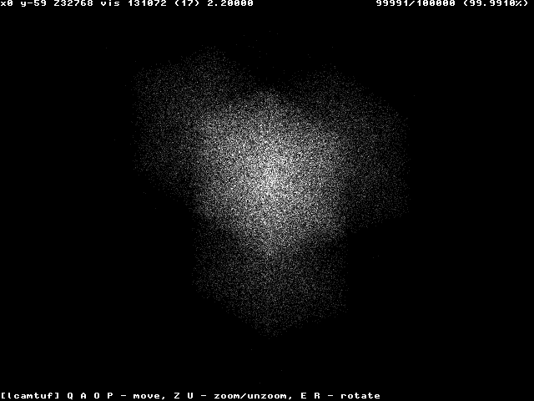
Windows 2000/XP

Slide 125
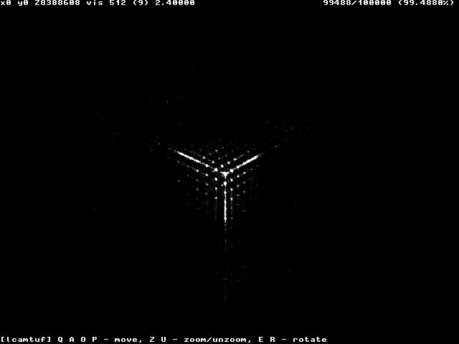
Windows 95/98

Slide 126
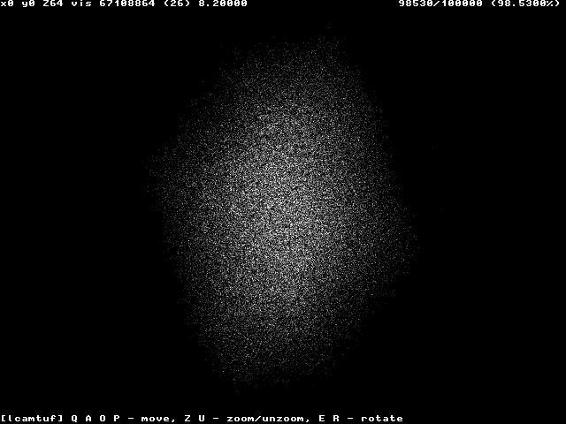
Linux

Slide 127
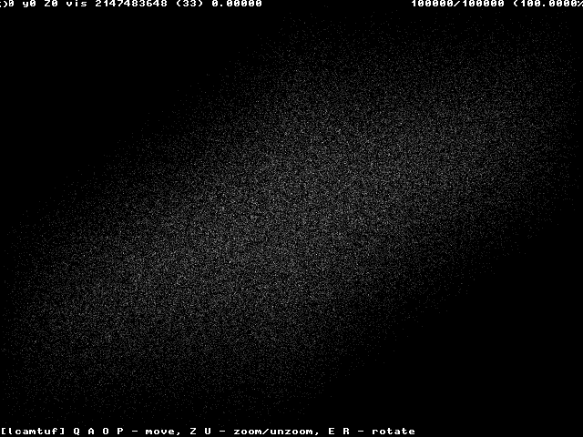
Free BSD

Slide 128
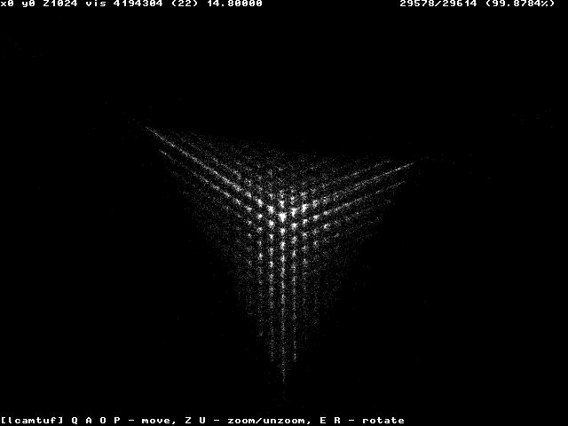
Cisco IOS Before The Cure

Slide 129
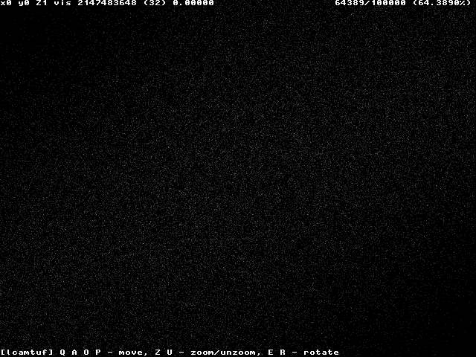
Cisco IOS After The Cure

Slide 130
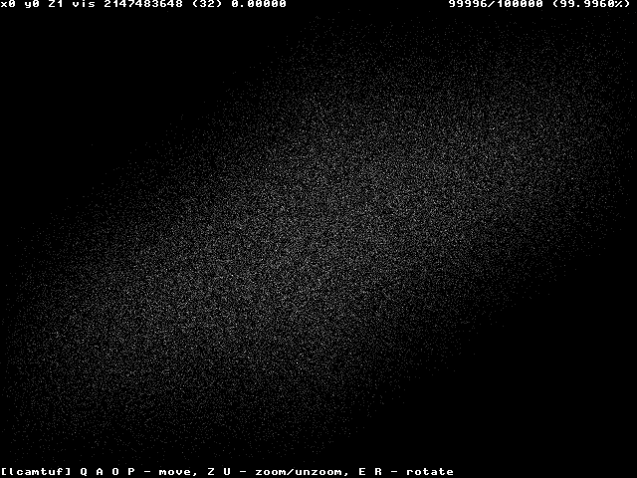
MacOS X

Slide 131
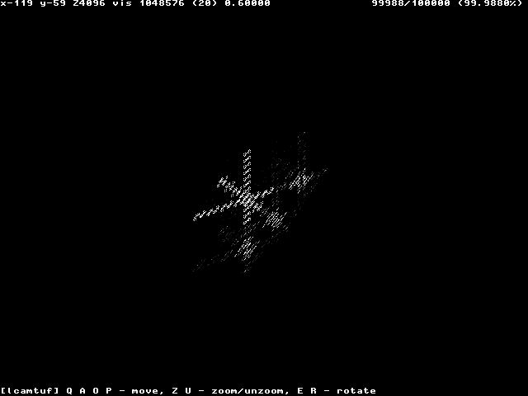
HP-UX Before The Cure

Slide 132
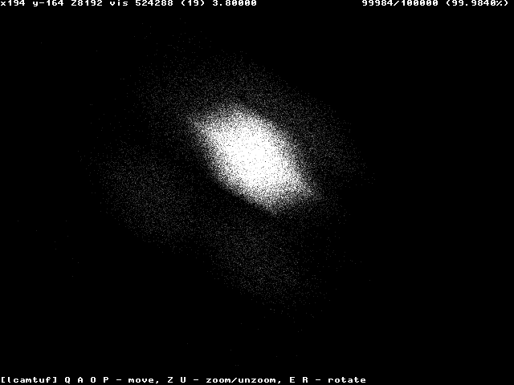
HP-UX After The Cure

Slide 133
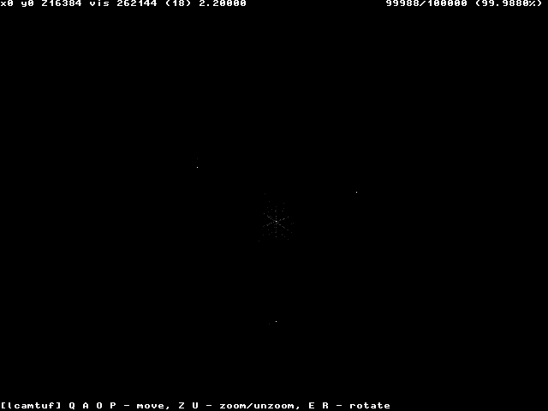
IRIX (w/out MD5 generation)

Slide 134
TCP Hijacking
Powerful technique to take control of an existing TCP connection
The attacker uses spoofed TCP segments to
Insert data in the streams
Reset an existing connection (denial of service)
The correct sequence/acknowledgment numbers must be used
The attacker can eavesdrop the traffic between client and server
The attacker can guess the correct seq/ack numbers
Described in “Simple Active Attack Against TCP” by L. Joncheray

Slide 135
TCP Hijacking
The attacker waits until the connection is “quiet”
All the transmitted data have been acknowledged (by both endpoints)
The attacker injects the data in the stream
“Desynchronizes” the connection
The receiver of the injected data sends an acknowledgment to the apparent sender
The apparent sender replies with an acknowledgement with the “expected” sequence number
The receiver considers this as out-of-sync and sends an an acknowledgement with the “expected” sequence number
....

Slide 136
TCP Hijacking
ACK messages with no data are not retransmitted in case of loss
The “ACK storm” continues until one message is lost
Any subsequent attempt to communicate will generate an ACK storm
ACK storms can be blocked by the attacker using ACK packets with the right numbers

Slide 137
TCP Hijacking
CL_SEQ = SVR_ACK
SVR_SEQ = CL_ACK
(3) Acknowledge SEQ=CL_SEQ!
(2) ACK=CL_SEQ + 30
(1) Spoofed TCP
with SEQ=CL_SEQ
and 30 bytes of data
Client
Server
Attacker

Slide 138
TCP Hijacking
This technique can be used against both client and server to completely hijack the communication channel (man-in-the-middle attack)
"Early desynchronization" can be achieved by the attacker by resetting existing connections and immediately opening new ones (between the same ports) with different initial sequence numbers

Slide 139
ACK Storm
192.168.1.10.1026 > 192.168.1.20.23: P 1015112:1015133(21) ack 4056578923
192.168.1.20.23 > 192.168.1.10.1026: . seq 4056578923 ack 1015133
192.168.1.10.1026 > 192.168.1.20.23: . seq 1015112 ack 4056578923
192.168.1.20.23 > 192.168.1.10.1026: . seq 4056578923 ack 1015133 192.168.1.10.1026 > 192.168.1.20.23: . seq 1015112 ack 4056578923
192.168.1.20.23 > 192.168.1.10.1026: . seq 4056578923 ack 1015133
192.168.1.10.1026 > 192.168.1.20.23: . seq 1015112 ack 4056578923
192.168.1.20.23 > 192.168.1.10.1026: . seq 4056578923 ack 1015133 192.168.1.10.1026 > 192.168.1.20.23: . seq 1015112 ack 4056578923
192.168.1.20.23 > 192.168.1.10.1026: . seq 4056578923 ack 1015133
192.168.1.10.1026 > 192.168.1.20.23: . seq 1015112 ack 4056578923
192.168.1.20.23 > 192.168.1.10.1026: . seq 4056578923 ack 1015133
192.168.1.10.1026 > 192.168.1.20.23: . seq 1015112 ack 4056578923
192.168.1.20.23 > 192.168.1.10.1026: . seq 4056578923 ack 1015133
192.168.1.10.1026 > 192.168.1.20.23: . seq 1015112 ack 4056578923
192.168.1.20.23 > 192.168.1.10.1026: . seq 4056578923 ack 1015133
192.168.1.10.1026 > 192.168.1.20.23: . seq 1015112 ack 4056578923

Slide 140
SYN-flooding Attack
Very common denial-of-service attack, aka Neptune
Attacker starts handshake with SYN-marked segment
Victim replies with SYN-ACK segment
Attacker… stays silent
Note that the source IP of the attacker can be spoofed, since the final ACK is not required
A host can keep a limited number of TCP connections in half-open state.
After that limit, it cannot accept any more connections

Slide 141
SYN-flooding Attack
Current solutions
Filtering
Increase the length of the half-open connection queue
Reduce the SYN-received timeout
Drop half-open connections when the limit has been reached and new requests for connection arrive
Limit the number of half-open connections from a specific source
Use SYN cookies
See TCP SYN Flooding Attacks and Common Mitigations, RFC 4987

Slide 142
SYN Cookies
Special algorithm used for determining the initial sequence number of the server
The number is
Top 5 bits: t mod 32, where t is a 32-bit time counter that increases every 64 seconds
Following 3 bits: the encoding of the Maximum Segment Size (MSS) chosen by the server in response to the client's MSS
A keyed hash of:
Counter t
Source/Destination IP addresses and ports

Slide 143
SYN Cookies
A server that uses SYN cookies sends back a SYN+ACK, exactly as if the SYN queue had been larger
When the server receives an ACK, it checks that the secret function works for a recent value of t, and then rebuilds the SYN queue entry (using the encoded MSS info)
Drawbacks:
The server sequence number grows faster than normal
The MSS value is limited by the encoding procedure (only 8 possible values)
No data can be included in the initial SYN

Slide 144
State Attacks
There are other attacks that exploit the fact that the server has to maintain a certain amount of memory/resources associated with each open TCP connection
Memory for the socket descriptor
Process or thread to manage the connection
Memory associated with the data in the TCP stream that has not yet been acknowledged
…

Slide 145
Summary
Networks are used to exchange data between nodes
It is important to understand what can and cannot be trusted
Attack building blocks
Sniffing
Spoofing
Hijacking
Denial-of-service
Brute-forcing
Tools
Countermeasures

